Slide 1

Market Segmentation
& Clustering Methods

Slide 2
MKT 591: Course Roadmap
Review of Quant Market Research
Prediction / Regression
Forecasting
Features & Dimensions
Market Segmentation
Simple Linear Regression
Demand Forecasting
Customer Classification
Factor Analysis
Segmentation General
Measurement Scales
Categorical Variables
BASS Diffusion Model
Discriminant Analysis
MDS
Advanced Model-based Segmentation
Discrete Analysis (CrossTab)
Extracting Features by Text Analytics
Multiple Regression
Bayesian Classifier
Spatial Segmentation
Continuous Analysis (Correlation)
Issues in Regression
Tree Models
Deep Learning
Logistic Regression (Consumer Choice)

Slide 3
Segmentation in Marketing
Strongest Impact of Marketing Tools (Roberts, Kayande, and Stremersch 2013)
Average Impact of Marketing Science Tools on Marketing Practice, According to Academics, Intermediaries, and Managers (ordered by intermediaries' perceptions, numbers represent average impact given awareness)
Tools/Approaches | Academics | Intermediaries | Managers
Segmentation tools | 4.29 | 4.44 | 4.02
Survey-based choice models | 3.71 | 4.15 | 3.25
Aggregate marketing mix models | 3.36 | 4.06 | 2.99
Pre-test market models | 3.93 | 3.94 | 3.38
Marketing metrics | 3.54 | 3.77 | 3.73
New product models | 3.78 | 3.74 | 3.37
Customer life time value models | 3.84 | 3.63 | 3.07
Panel-based choice models | 3.76 | 3.58 | 2.82
Perceptual mapping | 3.99 | 3.53 | 3.19
Customer satisfaction models | 3.83 | 3.39 | 3.59
Sales force allocation models | 3.62 | 3.23 | 3.07
Game theory models | 2.18 | 2.12 | 2.41

Slide 4
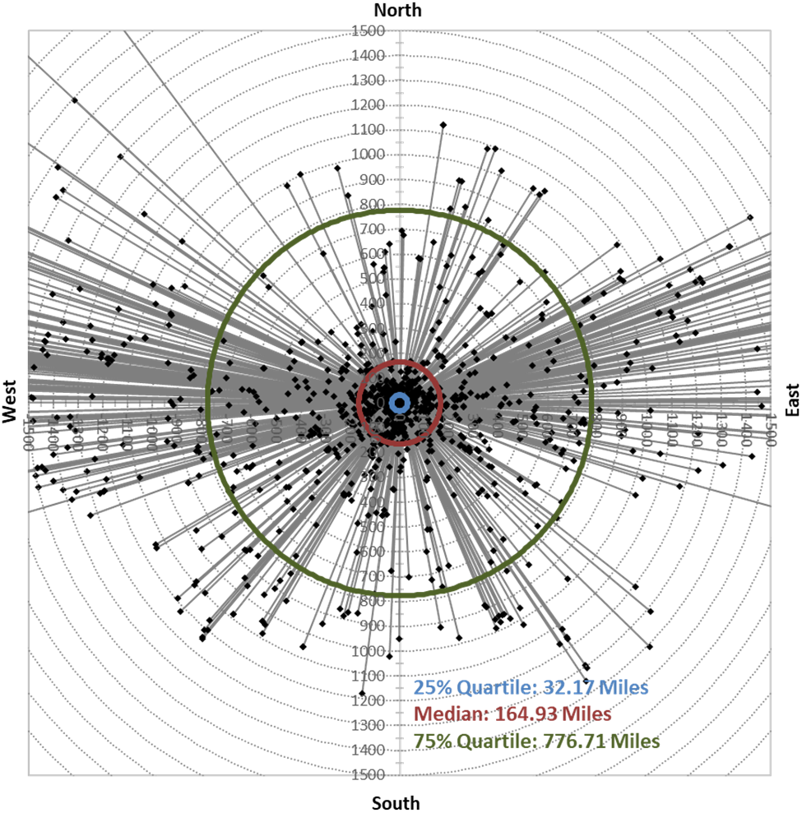
[Current Project using Model based Clustering] Sports Fan Diaspora: NFL Fan Diffusion (DeSarbo, Blank and Kim 2017)
Spots Fan Diaspora: Over 25% of the fans of an NFL teams lives over 775 miles away (Sports Business Journal, 2017)

Slide 5
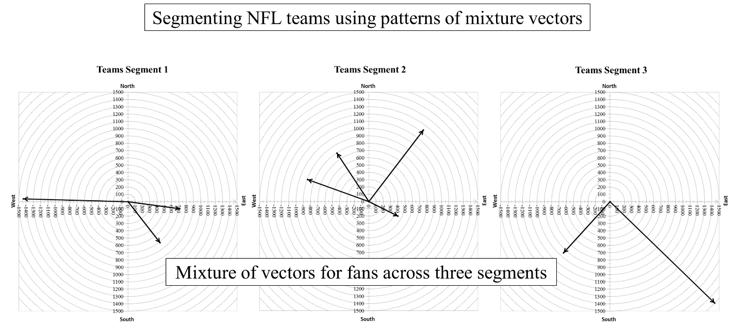
Model based Clustering NFL teams Based on Distance and Directions of Fans
Multi-level clustering: (1) clustering using distance and directions (NFL fans); (2) higher-level team clustering based pattern of distance and directions (3) iterations and converge.

Slide 6
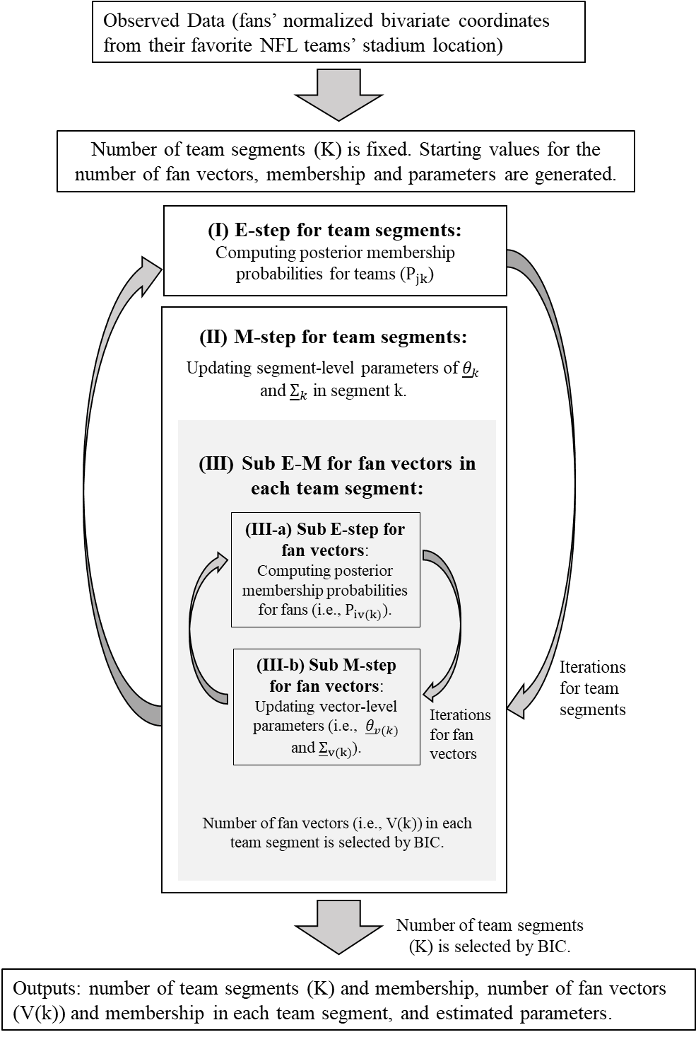
HIERARCHICAL E-M BI-CLUSTERING ALGORITHM
(Kim, Blank and DeSarbo 2019)

Slide 7
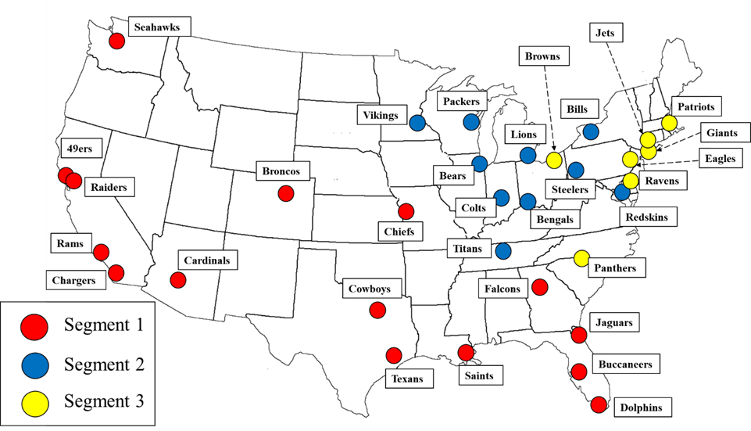
My Current NFL Teams Segmentation Project

Slide 8
For example, Segment 1: Arizona Cardinals, Atlanta Falcons, Dallas Cowboys, Denver Broncos, Houston Texans, Jacksonville Jaguars, Kansas City Chiefs, Los Angeles Rams, Miami Dolphins, New Orleans Saints, Oakland Raiders, San Diego Chargers, San Francisco 49ers, Seattle Seahawks, and Tampa Bay Buccaneers.

Slide 9
Segment | Vectors | Attend at Least 1 Home Game | Attend at Least 1 Away Game | Watch at Least 1 Game over the Internet | Follow at Least 1 Game on Social Media
K = 1 | V = 1 | 46% | 7% | 55% | 70%
 | V = 2 | 43% | 8% | 66% | 65%
 | V = 3 ª | 13% | 23% | 65% | 80%
 | V = 4 ª | 12% | 18% | 64% | 62%
 | V = 5 ª | 19% | 15% | 61% | 65%
 | Seg. Total | 31% | 12% | 61% | 67%
K = 2 | V = 1 | 50% | 10% | 43% | 68%
 | V = 2 | 36% | 10% | 60% | 72%
 | V = 3 ª | 40% | 50% | 90% | 90%
 | V = 4 ª | 14% | 16% | 81% | 61%
 | V = 5 ª | 18% | 17% | 77% | 80%
 | V = 6 | 25% | 8% | 50% | 75%
 | V = 7 ª | 14% | 19% | 71% | 86%
 | Seg. Total | 32% | 13% | 63% | 72%
K = 3 | V = 1 ª | 20% | 12% | 70% | 79%
 | V = 2 | 50% | 11% | 58% | 71%
 | V = 3 ª | 19% | 30% | 78% | 67%
 | V = 4 | 33% | 5% | 57% | 59%
 | V = 5 ª | 7% | 0% | 86% | 71%
 | V = 6 ª | 10% | 14% | 83% | 66%
 | Seg. Total | 31% | 11% | 64% | 68%
Note: yellow lines represent “diaspora group”

Slide 10
Conceptual Backgrounds of Market Segmentation in Marketing

Slide 11
Market Segmentation: Academic Definition by Smith (1956):
“Market Segmentation involves viewing a heterogeneous market as a number of smaller homogeneous markets with differing preferences attributable to the desires of consumers for more precise satisfactions of their varying wants”

Slide 12

Market Segmentation in Plain English
Process of dividing a total market into groups of consumers who have similar needs and who respond similarly to marketing mix variables.
?
?
?

Slide 13
Basic Market-Preference Patterns
(a) Homogeneous
Preferences
(Aggregate Model)
(b) Diffused
Preferences
(Individual-level model)
(c) Clustered
Preferences
(Segmentation Model)
Creaminess
Creaminess
Creaminess
Sweetness
Sweetness
Sweetness
Notes:
6
6
6
Still we can cluster market given interesting attributes.

Slide 14
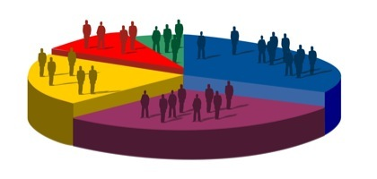
Different Levels of Market Segmentation
Aggregate Marketing - “any color as long as its black”
Aggregate marketing strategy – aggregate regression approach
hard to find examples: E.g., market in old times.
Segment Marketing - large identifiable subgroups within a market
discrete market segmentation method – this class focuses on this
consumer packaged goods

Slide 15
Levels of Market Segmentation
Niche Marketing – sub segments with distinctive traits
Apple (Steve Jobs) targeted the Mac at niche segments such as graphic design or publishing in the 1980s (cbsnews.com 2008)
Starbucks was initially a niche strategy that became mainstream (cbsnews.com 2008)
Individual / One to One Marketing -
Individual Level Regression analysis (see Bayesian Hierarchical Regression)
We need multiple data points per individual/household.
Amazon Recommendations, Financial Products (e.g., Credit Card), Dell PC

Slide 16
Segmentation, Targeting, and Positioning (STP Strategy)
Market
Segmentation
Market
Targeting
Market
Positioning
1. Identify
segmentation
variables and
segment the
market
2. Develop
profiles of
resulting
Segments
3. Evaluate
attractiveness
of each
segment
4. Select the
target
segment(s)
5. Identify
possible
positioning
concepts for
each target
segment
6. Select,
develop, and
communicate
the chosen
positioning
concept
Notes:
5
5
5

Slide 17
STP Strategy
Segmentation
Targeting
Positioning
A. Segmentation
1. Leads to efficient 4P marketing strategy (e.g., resource allocation for promotion, product development);
2. Better able to find market opportunities (i.e., different people have different preference);
3. Leads to a more precise setting of objectives via sales, profit, costs, market share, R.O.I., etc...
4. Thus, better able to satisfy customer needs.

Slide 18
B. “When consider Segmentation?”
Identifiability
Behaviorally Different
Substantiality (e.g., what if the identified segment is too small?)
Accessibility
Stability (e.g, what if the segment is changing every moment?)
Responsiveness
Actionability
Predictability
Profitability
If “yes” to these criteria, then segment

Slide 19
Basis for Segmenting
Demographic
Age, gender, family size,
life cycle, income
Easy and classic criteria
1. Geographic Region County City Density Climate
2. Demographic Age Sex Family Size Life Cycle Income Occupation Education Religion Race Nationality Social Class
Geographic
Nations, states,
regions or cities

Slide 20
3. Psychographic
Life Style
Personality
Attitudes
Opinions
Psychographic
Social class, lifestyle, or values
Behavioristic Purchase Occasion (Business, Vacation, Family...) User Status (Non, Ex, 1st-time, Regular) Usage Rate (Hi, Med, Lo) Loyalty Status Readiness Stage (Towards Buying) Marketing - Factor Sensitivity, Responsiveness to marketing mixes. Preferences for Product Characteristics (e.g., price, quality, service)
Behavioral
RFM, usage, responses, Profits

Slide 21
TECHNIQUE SELECTION DEPENDS UPON TYPE OF SEGMENTATION STUDY:
A priori segmentation (classic and easier).
the basis for segmentation--such as usage, product purchase frequency--is specified in advance of the segmentation analysis.
the segments are defined a priori and the analysis centers on profiling the various subgroups of consumers on the basis of product-use characteristics, size, demographic variables, psychographics, and other relevant characteristics. (e.g., 20-30 Female segment)

Slide 22
TECHNIQUE SELECTION DEPENDS UPON TYPE OF SEGMENTATION STUDY:
2. Segmentation based on Data structure (e.g., model-based).
In post-hoc segmentation designs, segments are defined after the fact on the basis of some sort of clustering of respondents on a set of “relevant” characteristics such as benefit sought, need, or attitudes (e.g., segment who are pursuing “money for value”).
Once the segments have been formed, they are profiled on the basis of size, product-use characteristics, and respondent background variables.

Slide 23


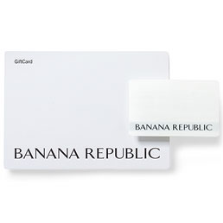

Segmentation Example: Apparel Industry
Gap Inc. has multiple brands targeting different segments.

Slide 24
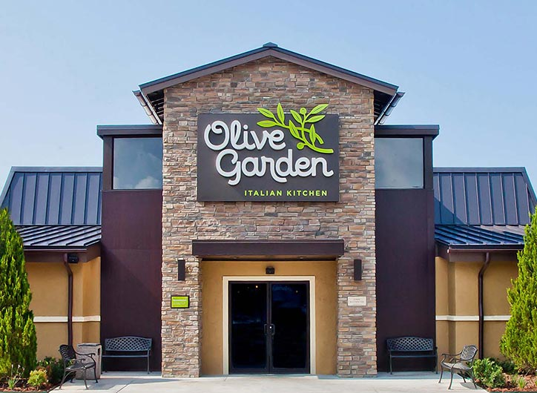
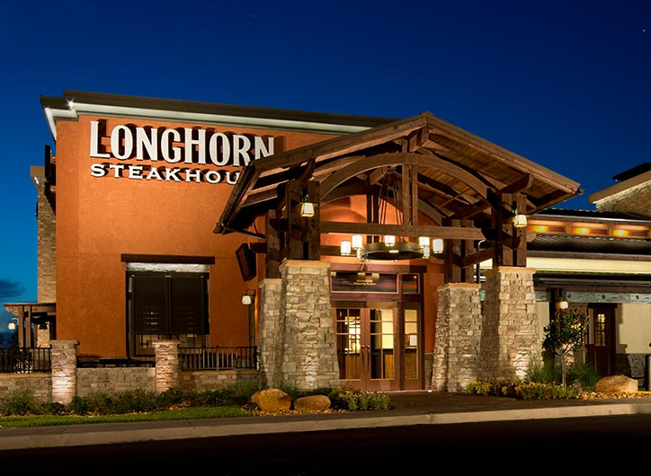
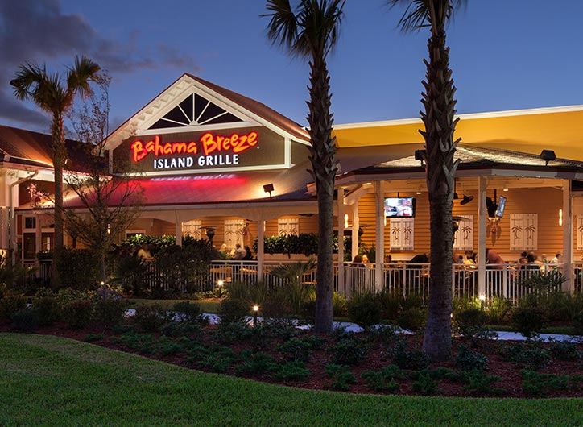
Examples: Restaurants
Darden has multiple brands targeting different segments.
To maximize share of wallet and to minimize cannibalization across brands, proper positioning strategy across different segments are important – it’s important to understand segments of this market.

Slide 25





Segmentation Modeling Example
DV:
Choice or Satisfaction
Segment 1 (20%)
Problem Solving
Idea: Different people care different product/service features!
Care
Modern-Looking
Problem Solving
Prompt Service
Care
Segment 2 (30%)
Safety
Courtesy
Courtesy
Notes:
Let’s revisit to Bernie’s problem!

Slide 26



Segmentation Modeling with Variable Selection (Kim et al. 2012)
Regression analysis per derived segment
Segmentation:
allocating individuals to each segment
Variable selection: searching key drivers per derived segment
Notes:
Bayesian variable selection

Slide 27
The Proposed Models: Model Selection
 | K=1 | K=2 | K=3 | K=4 | K=5
DIC | 2480.1 | 2291.7 | 2299.8 | 2339.2 | 2408.5
BIC | 2522.8 | 2429.7 | 2473.1 | 2500.7 | 2682.4
K=2 has been selected (Note: Select Lower values in DIC and BIC).
Notes:
First of all, the higher value in model selection heuristics means better solution. For Unconstrained model, 2 Segment is the best solution. For common Factors, … However, overall 2 segment solution of the Distinctive factors model is the best solution.

Slide 28
Important Features across Segments
 | Segment 1 |  | Segment 2
 | Coeffs | Odds Ratio | Coeffs | Odds Ratio
intercept | -4.16 | +Inf | -3.41 | +Inf
foreign | -0.67 | 550.56 | 0 | 0
gasmile | 0 | 0 | 0 | 0
value4money | 0 | 0 | 0.21 | 126.58
workmanship | 0 | 0 | 0 | 0
ride-handling | 0 | 0 | 0 | 0
load-unload | 0.14 | 127.74 | 0 | 0
luxurious | 0 | 0 | 0 | 0
safety | 0 | 0 | 0 | 0
ride-offroad | 0 | 0 | 0 | 0
rugged | 0 | 0 | 0 | 0
towing | 0 | 0 | 0 | 0
price | 0 | 0 | 0.1 | 132.61
sporty | 0 | 0 | 0 | 0
good-looking | 0.18 | +Inf | 0.19 | +Inf
family-use | 0.11 | 30.97 | 0 | 0
fun2drive | 0 | 0 | 0 | 0
passenger room | 0 | 0 | 0 | 0
enter-exit | 0 | 0 | 0 | 0
dependable | 0 | 0 | 0 | 0
acceleration | 0 | 0 | 0 | 0
cargo space | 0 | 0 | 0 | 0
prestigious | 0 | 0 | 0 | 0
tech-adv | 0 | 0 | 0 | 0
trade-in | 0 | 0 | 0 | 0
Mixture | 59% |  | 41%

Slide 29
Post-hoc Analysis (possible managerial implications)
Managerial Implications: Firms should effectively communicate this segment with family-valued messages through traditional communication channels.
Significantly higher marriage rate (80.7% vs. 68.1%, p<0.03), higher household size (3.31 vs. 3, p<0.07) and less likely to use the Internet (55% vs. 70.6%, p<0.05). More likely to be Caucasian (80% vs. 76.5%, p<0.05).
“Family Oriented” Segment pursing convenience (59%)
Selected Features: “Not Foreign brands”, “Easy for loading & unloading”, “Good looking”, “Family use”
“Economic Value” Segment (41%)
Selected Features: “Value for the money”, “Reasonable price”, “Good looking”
Lower marriage rate, stronger tendency to use Internet and lower average household sizes.
Managerial Implications: firms should focus on a pricing strategy and communicate the economic value of SUV’s using more online communication channels.
Note, “Good looking” feature is selected across both segments.
Notes:
Don’t explain too much here. Seg 1 is less satisfied but more potential for long-term profitable customer group. So at the early state of relation ship, National should care this group with selected variables. Done!

Slide 30
Example for Carpet Fibers
Segmenting market based on similarity in two dimensions and distances between cluster centers.
Segmentation by Finding Hidden Structure of Data!
-- Unsupervised Learning
Perceptions/Ratings for one respondent
..
..
.
.
.
.
.
.
.
.
.
.
.
.
.
.
.
D
.
A
.
.
.
.
.
.
.
Strength
feature
..
..
Distance between
segments C and D
.
.
.
.
.
.
B
.
.
.
.
.
.
C
.
.
.
.
.
A,B,C,D:
segment centers.
Expected members:
A: schools
B: light commercial
C: outdoor carpeting
D: health clubs
.
.
.
.
.
.
.
Water Resistance
feature
Notes:
26
26
School-inside: Strong endurance is important but water resistance is relatively less important compared to outdoor carpeting or health clubs.

Slide 31
METHODOLOGIES FOR
MARKET SEGMENTATION--”HOW”
Various Statistical Approaches:
1. CART
2. (Discrete) Multiple Regression
3. Cluster Analysis
4. ANOVA, MANOVA
5. Discriminant Analysis
6. Latent Structure Techniques
7. Multidimensional Scaling
8. Bayesian Methods, etc…….

Slide 32

Clustering Methods
Hierarchical Clustering (distance based) old method
K-means Method (distance based)
Model-based Clustering (distribution assumption)

Slide 33
Cluster Analysis
Cluster analysis is a technique used to identify groups of ‘similar’ customers in a market (can be market segmentation) – It’s Not Regression-Based Approach but matrix based approach.
Cluster analysis encompasses a number of different algorithms for grouping objects of similar kind into categories – Unsupervised Learning

Slide 34
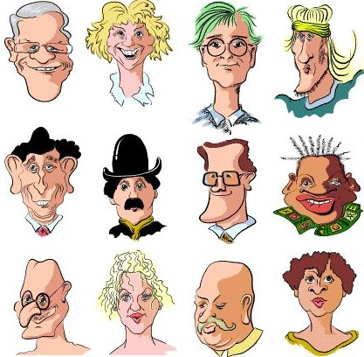
Starting example: What do we mean by “similar”?

Slide 35
It’s important to choose what are “bases”…
case
sex
glasses
moustache
smile
hat
1
m
y
n
y
n
2
f
n
n
y
n
3
m
y
n
n
n
4
m
n
n
n
n
5
m
n
n
y
n
6
m
n
y
n
y
7
m
y
n
y
n
8
m
n
n
y
n
9
m
y
y
y
n
10
f
n
n
n
n
11
m
n
y
n
n
12
f
n
n
n
n

Slide 36
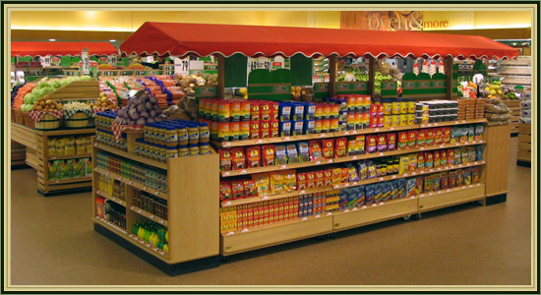
Clustering is a classic, important problems in diverse fields!
Application Examples:
In grocery stores items of similar nature, such as different types of meat or vegetables are displayed in the same or nearby locations.
Biologists have to organize the different species of animals-- man belongs to the primates, the mammals, the amniotes, the vertebrates, and the animals.
In medicine, clustering diseases, cures for diseases, or symptoms of diseases can lead to very useful taxonomies.

Slide 37
Between and Within Cluster Variation
Cluster analysis works on the principle of maximizing the between-cluster variance while minimizing the within-cluster variance
Distance between cluster centers
Distance from a cluster center to a cluster member

Slide 38
Hierarchical Method
Begin with each customer in a class by itself (segment of 1).
Now lets lower our threshold and link more and more customers together and aggregate larger and larger segments of increasingly dissimilar customers.
In the last step, all customers are joined together.
A commonly used method is to find the pair of clusters that leads to minimum increase in within-cluster variance after merging (e.g., Ward's procedure).
Notes:
Ward’s method – minimum variance criterion. Find the pair of clusters that leads to minimum increase in total within-cluster variance after merging. Recursive algorithm. Euclidean distance.

Slide 39
Hierarchical Method and K-mean Clustering in R
Segmentation data (see p 113 of textbook):
Four identifiable segments of customers for a subscription products (e.g., suburb mix, urban hip, travelers and moving up).
It contains a few variables that are similar to data from typical consumer surveys: age, gender, income, kids, ownHome, subscribe.

Slide 40
Let’s try hierarchical clustering in R
Please compute dissimilarity matrix (e.g., distance) by using ‘daisy’ function commands.
Let’s decide the number of segments based on hierarchical plot.
What are the difference (e.g., mean value of age or income) across segments?

Slide 41
Decision for number of segments?
Analyst specify the number of segments desired
2 Seg?
4 Seg?
7 Seg?

Slide 42
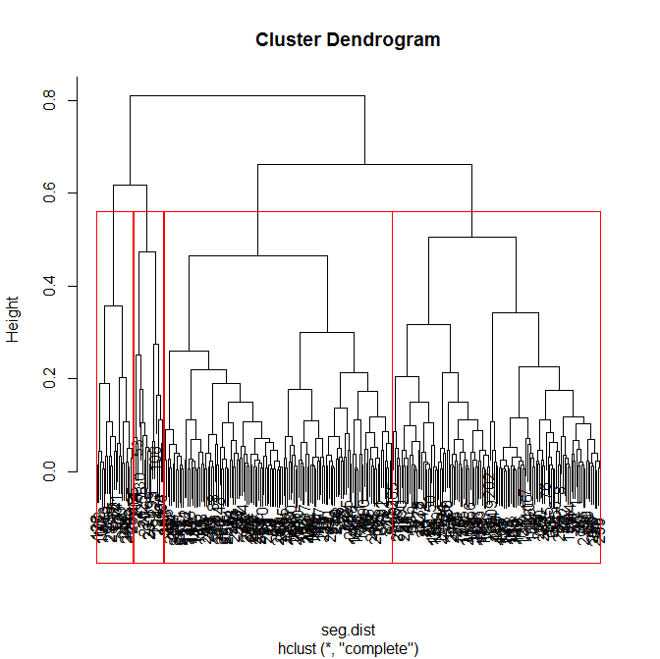
When there is a big jump along the horizontal axis this indicates that two
dissimilar clusters have
been joined.
The vertical axis measures dissimilarity

Slide 43
k-Means Clustering
Suppose that you already have hypotheses concerning the number of clusters/segments
You may want to "tell" the computer to form exactly “k” clusters that are to be as distinct as possible.
Goal is to 1) minimize variability within clusters and 2) maximize variability between clusters
The main advantage of this algorithm is its flexibility and robustness in finding the most appropriate grouping of individuals.

Slide 44
Let’s try K-means method in R
Let’s use the number of segments from hierarchical clustering.
Let’s compare the segment-wise differences (e.g., mean value of age or income) with the results with hierarchical clustering. Is that similar?

Slide 45
In Practice…
Hierarchical and nonhierarchical methods are used in tandem. First, an initial clustering solution can be (graphically) obtained using a hierarchical procedure.
Determine the number of segments and use k-mean clustering
Theoretical, conceptual, or practical considerations may suggest a certain number of clusters – we had an example for this in Dupont case.
We can use the Model Based Clustering based on statistical assumption – you can use selection criteria (e.g., BIC)

Slide 46
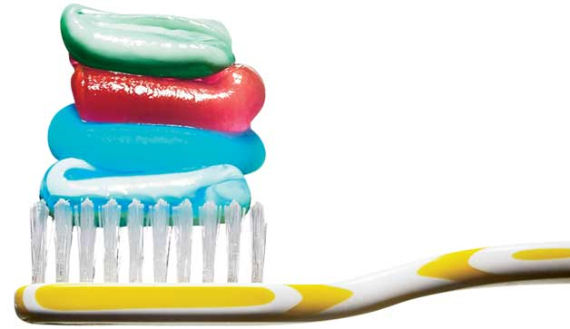
Cluster Analysis with “Toothpaste Market Case”
Use data file “toothpaste_data.sav”
Objective – run a Cluster Analysis to:
Identify # of clusters/segments.
Assign each customer to a cluster/segment.
Describe each cluster/segment.

Slide 47
Toothpaste Data
30 respondents were asked to rate the following statements on a 7-point Likert Scale:
It is important to buy a toothpaste that prevents cavities.
I like a toothpaste that gives shiny teeth.
A toothpaste should strengthen gums.
I prefer a toothpaste that freshens breath.
Prevention of tooth decay is not an important benefit offered by a toothpaste. (reverse coded)
The most important consideration in buying a toothpaste is attractive teeth.
1 = strongly disagree; 7 = strongly agree

Slide 48
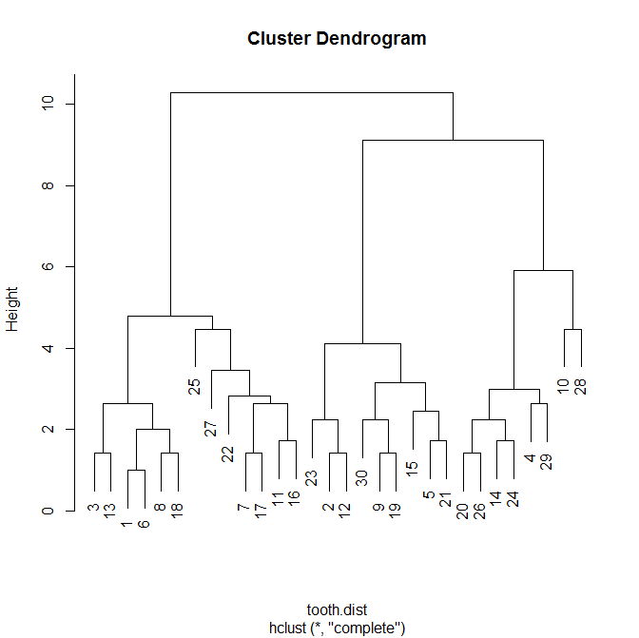
1. Cluster Analysis: Hierarchical Clustering
Here is the jump!
How many clusters will you decide for this dataset?
Here is the jump!
Here is the jump!

Slide 49
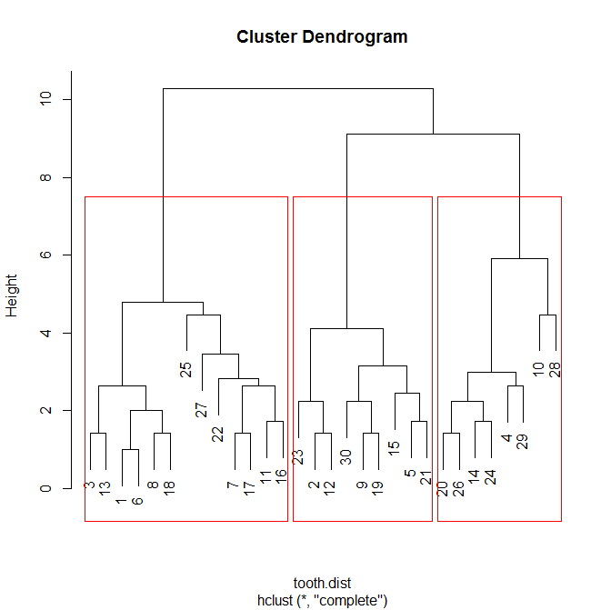
Cluster Analysis: Hierarchical
Use the Dendrogram to determine how many clusters should be extracted.
Look for a ‘jump’ along the horizontal axis of the Dendrogram. At that point 3 dissimilar clusters have been grouped together.
Once you decide on the # of clusters (3 here), use K-means clustering to calculate the final cluster solution.

Slide 50
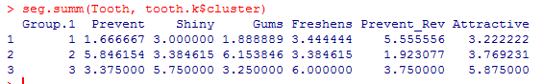
2. Let’s run K-Means for cluster analysis
for Toothpaste data (K=3)
 | Segment1 | Segment2 | Segment3
Prevent | 1.67 | 5.85 | 3.38
Shiny | 3 | 3.38 | 5.75
Gums | 1.89 | 6.15 | 3.25
Freshens | 3.44 | 3.38 | 6
Prevent(R) | 5.56 | 1.92 | 3.75
Attractive | 3.22 | 3.77 | 5.88
Cluster 1: Uninvolved Brushers
Cluster 2: Therapeutic Brushers
Cluster 3: Cosmetic Brushers

Slide 51
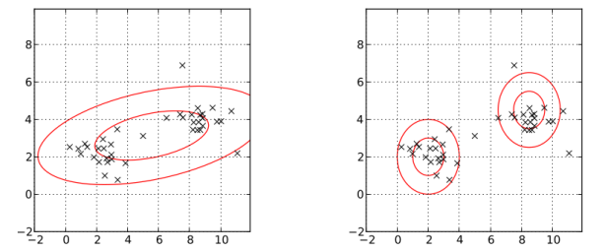
Model-based Clustering
Assuming the distribution of the sample data look like below…
We can make statistical distribution assumption of two or more mixtures of Gaussian distributions.

Slide 52
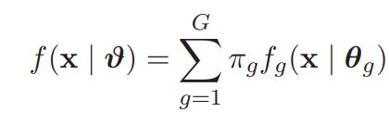
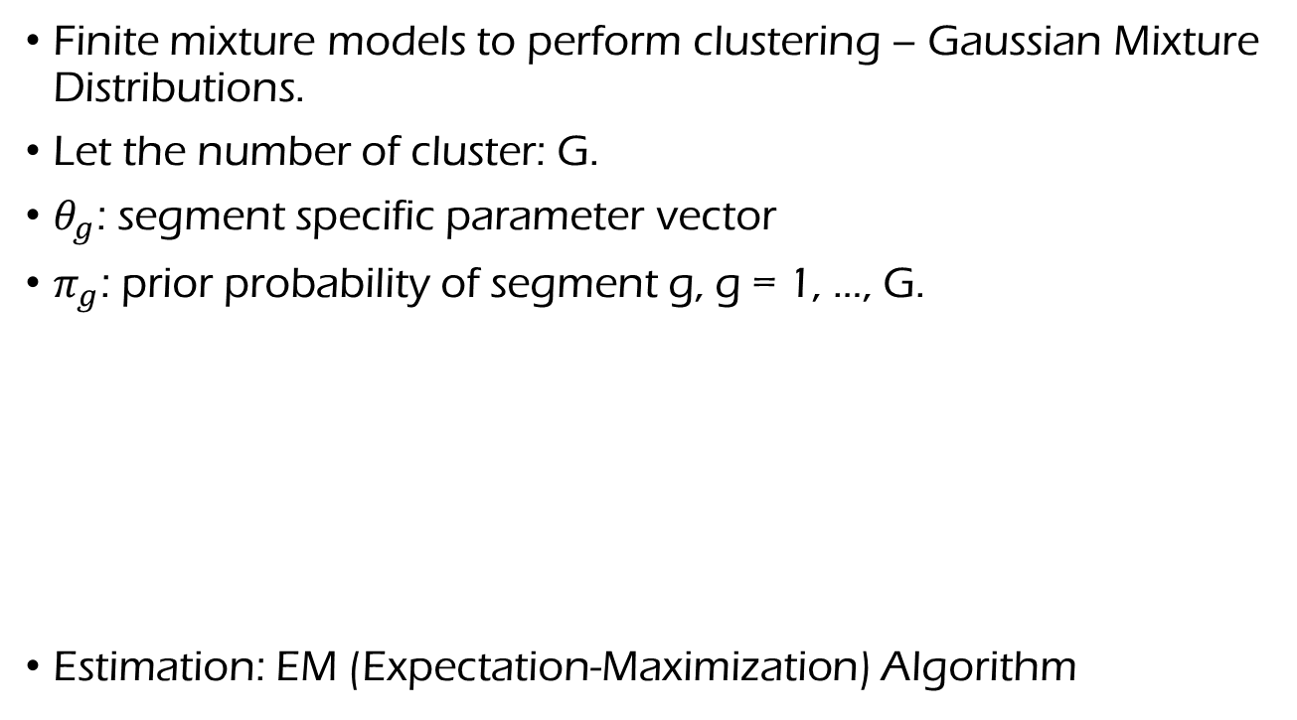
Model-based Clustering
Finite mixture models to perform clustering – Gaussian Mixture Distributions.
Let the number of cluster: G.
$θ_{g}$: segment specific parameter vector
$π_{g}$: prior probability of segment g, g = 1, …, G.
Estimation: EM (Expectation-Maximization) Algorithm
Finite Mixture: Latent Variable
McNicholas (2016)

Slide 53
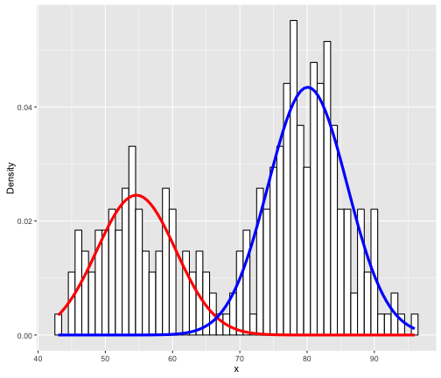
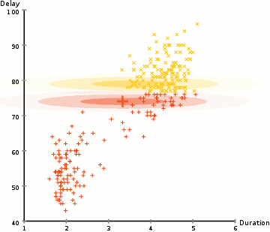
Model-based Clustering in R
Let’s run model-based clustering package in R (“mclust” package)
We can choose the optimal number of clusters based on the model selection criteria of BIC.
Notes:
Various BIC values based on Within-Cluster distribution assumptions. Choose best value for finding best clusters fit.

Slide 54
Appendix:
K-Means Clustering
- Nonhierarchical; renders partitions
- User must specify k = the number of clusters desired
- Statistics: Means S.D.’s Case ID in Clusters - Tries to assign cases to clusters to minimize within sums of squares.
Algorithm:
i. Assume k clusters. Select k cases at random and define k cluster means
ii. Assign each of the remaining N-k cases to the cluster that is closest, i.e.,

Slide 55
iii. Update cluster means
iv. Go to step ii as long as within sum of squares gets smaller, i.e., until
is minimum.
Note:
Starting k points can affect results (Random Start)
: To replicate the results, you need to set seed number in R
Application: Test market data

